Slide 1
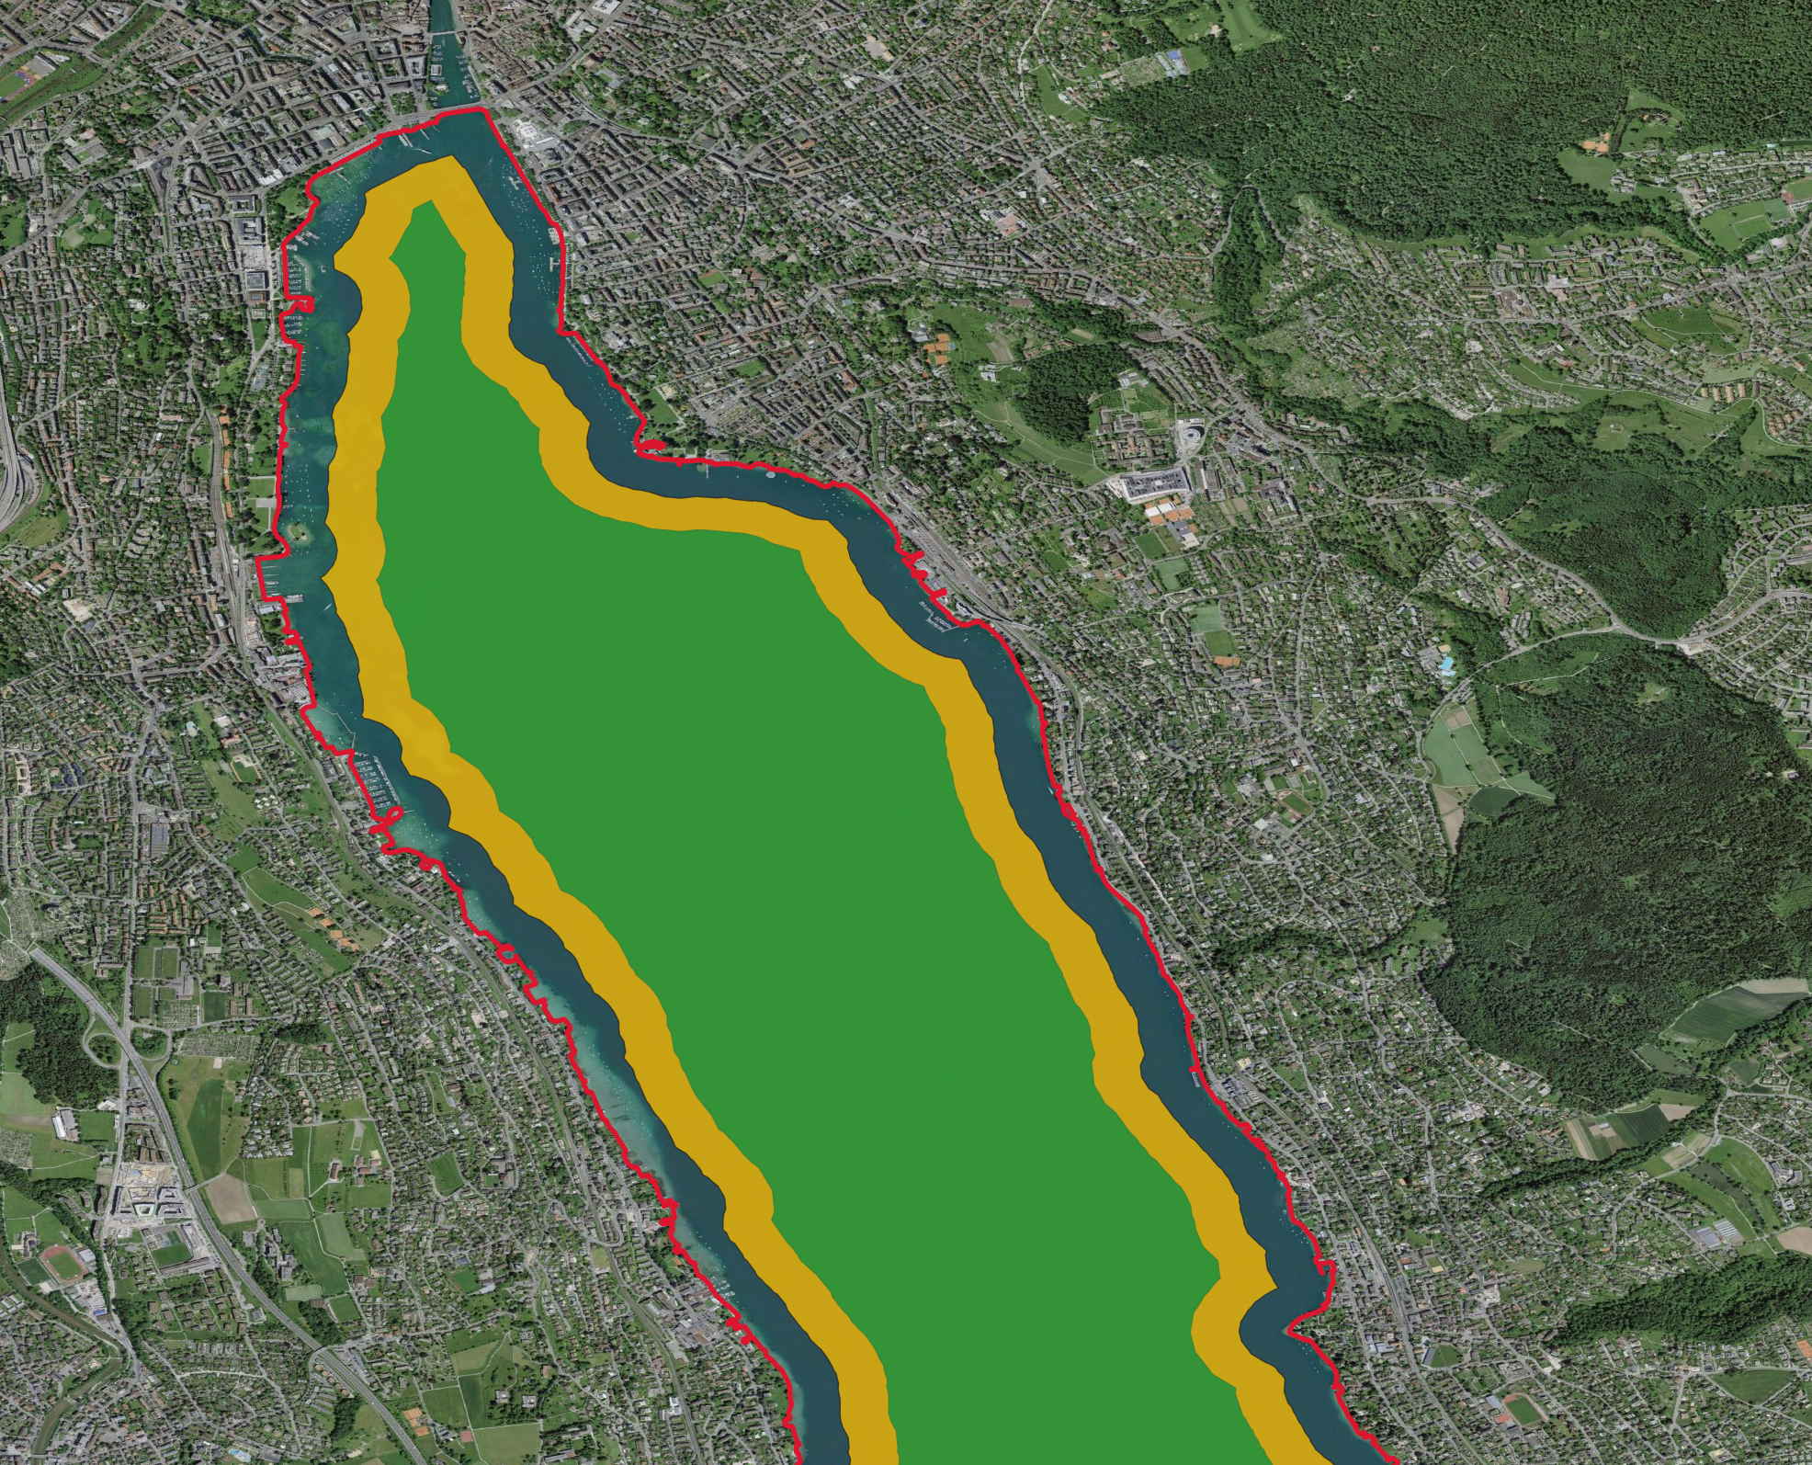
Legend
Shoreline - Rule: Drive perpendicular, max 10 km/h, no wake.
150m zone - Rule: parrallel aloud. Limit = 10km/h.
300m zone - Rule: no speed limit.

Slide 2
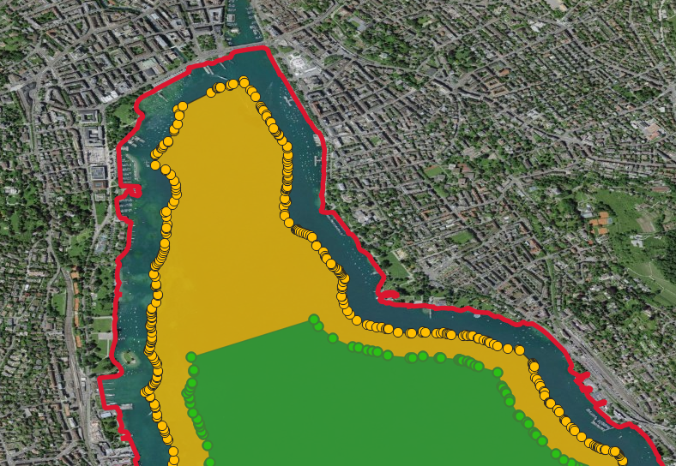

Slide 3
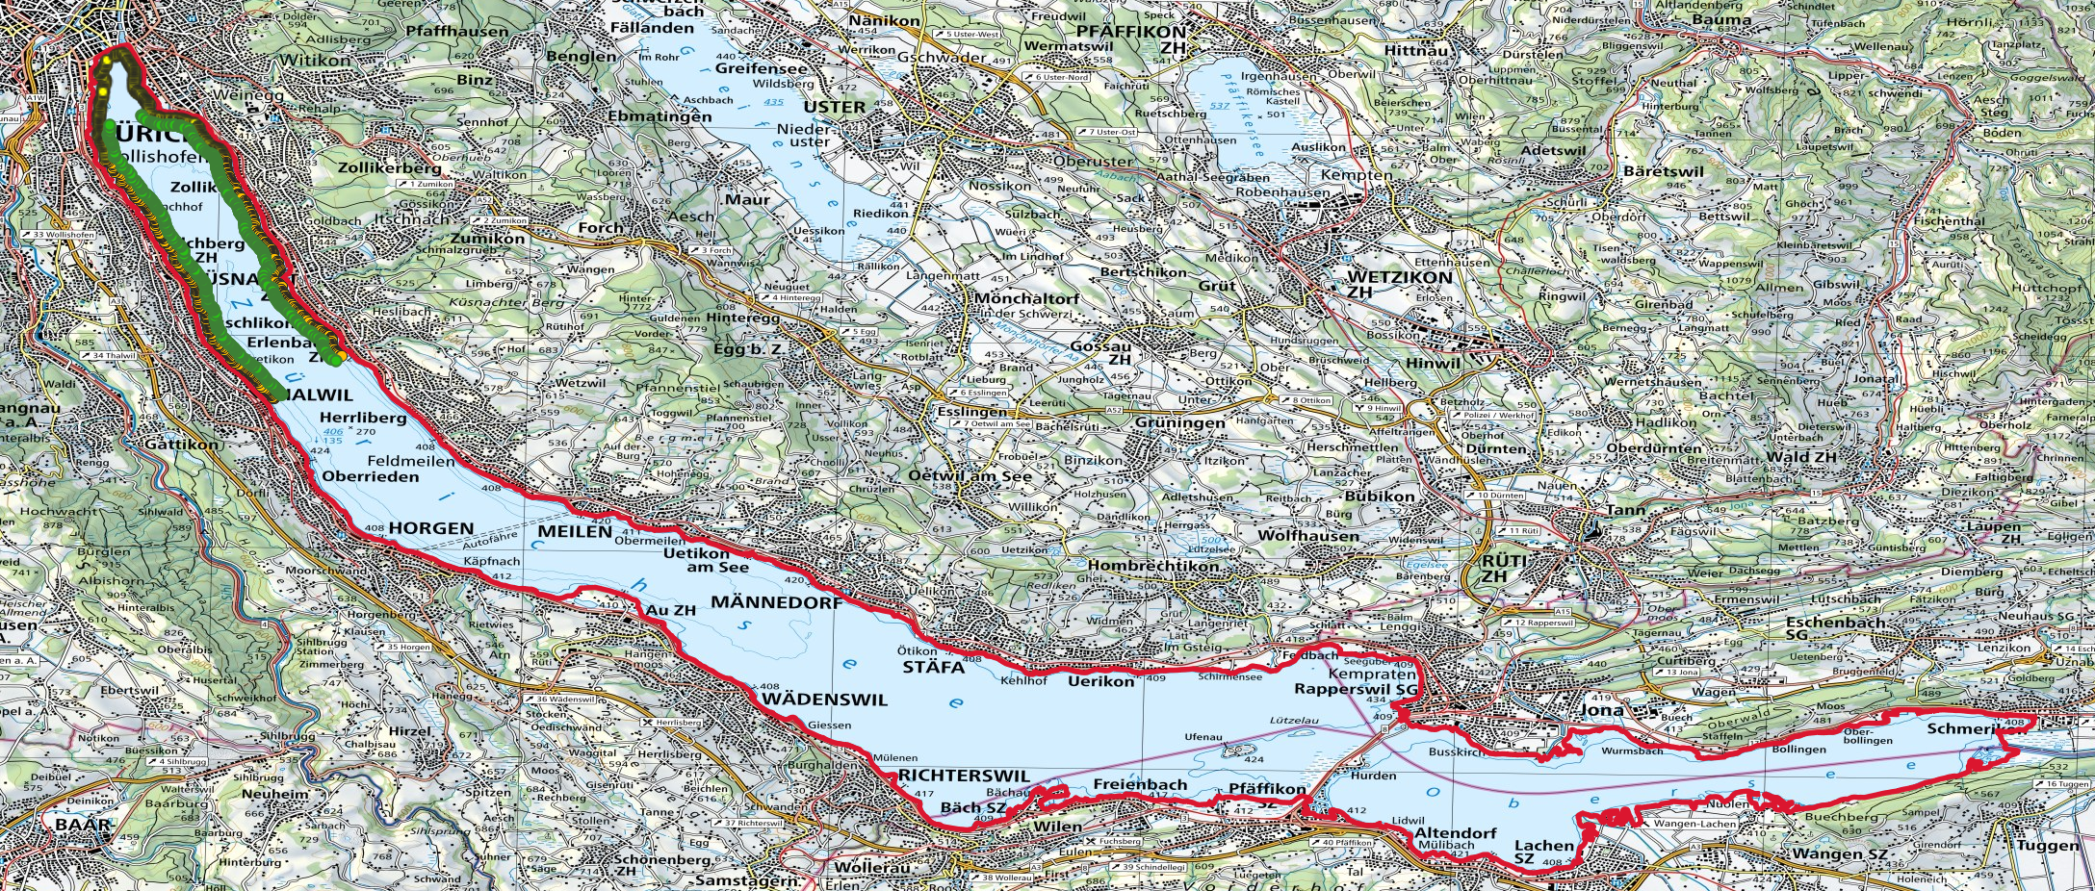

Slide 4
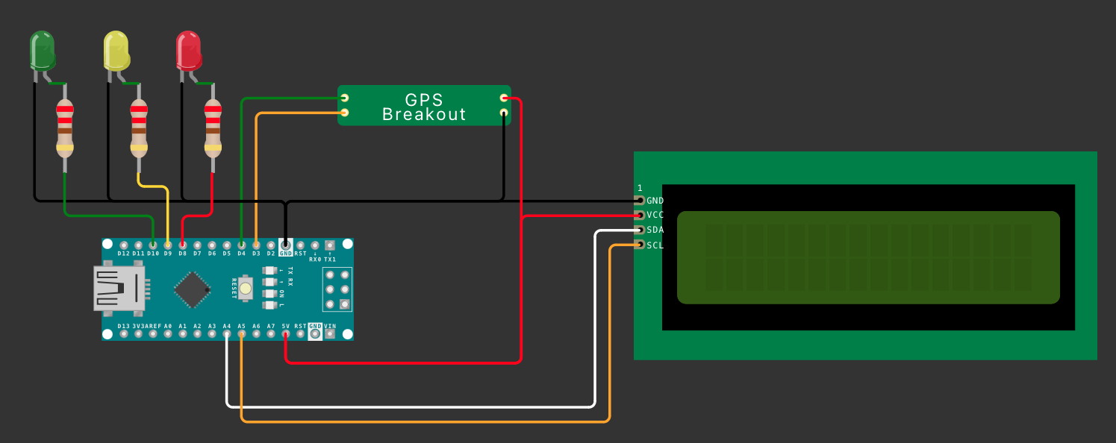
TX
VCC
RX
GND

